Slide 1
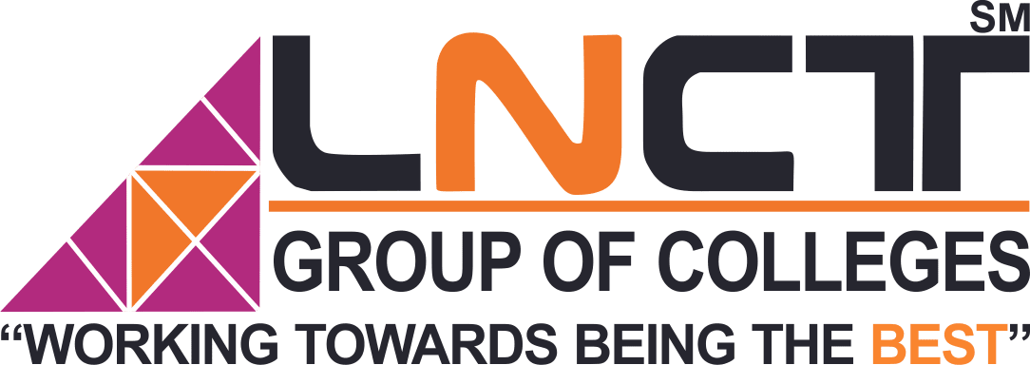
Name Avantika Gupta
Enrollment No. 0103CA201030
Topic Employee management
system using java
Submitted To
Mr. Praveen Sharma

Slide 2
Abstract
In this world of growing technologies everything has been computerized. With large number of work opportunities the Human workforce has increased. Thus there is a need of a system which handle the data of such a large number of employees in an organization. This project simplifies the task of maintain records because of its user friendly nature.
The “Employee Management System” has been developed to override the problems prevailing in the practicing manual system. This software is supported to eliminate and in some cases reduce the hardships faced by this existing system. Moreover the system is designed for the particular need of the company to carry out operations in a smooth and effective out operations in a smooth and effective manner.

Slide 3
The application is reduced as much as possible to avoid errors while entering the data. It also provides error message while entering invalid data. No formal knowledge is needed for the user to use this system. Thus by this all it proves it is user-friendly.
This project will allow admin to add new employees after proper authentication. Admin can also add new departments and posts. Database should store all personal details of employees such as date of birth, full name etc. and his educational background, work experience, skills sets, current and past projects in different tables with proper relations.

Slide 4
Introduction
Every organization, whether big or small, has human resource challenges to overcome, very organization has different employee management needs, therefore I design exclusive employee management system that are adapted to your managerial requirements. This is designed to assist in strategic planning, and help you ensure that your organization is equipped with the right level of human resources for your future goals. Also, for busy executive who are always on the go, our systems come with remote access features, which will allow on the go, our systems come with remote access features, which will allow always you to manage your workforce anytime, at all times. These systems will ultimately allow you to better manage resources. One of the main features in employee management system is time tracking for employees. Effective time tracking mechanism saves both time and money for the organization

Slide 5
Flow Charts
Case Diagram
Add Employee
View Employee
Remove Employee
Update Employee
All Employee
Admin
Modules

Slide 6
Sequence Diagram
User
Application
Database
Open Application
Enter Login Credentials
Successfully Logged in
Select Required option
Request for required option
Required option select successfully
Display Required Page
Insert the required details
Passes entered details
Details entered successfully
Display the details entered
Select Record
Request For Report
Display the Report
Report

Slide 7
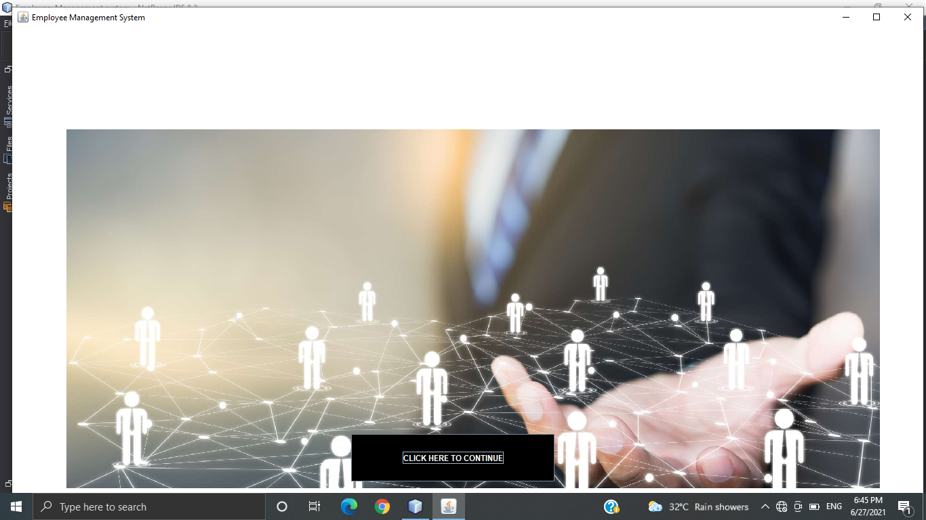
Starting Page

Slide 8
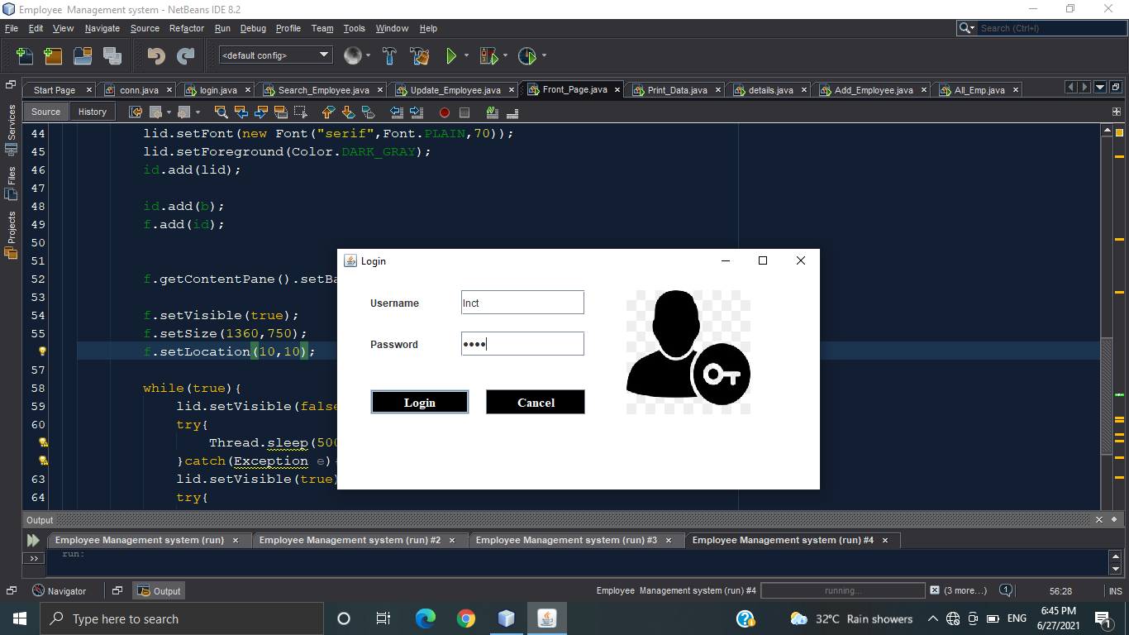
Login Page

Slide 9
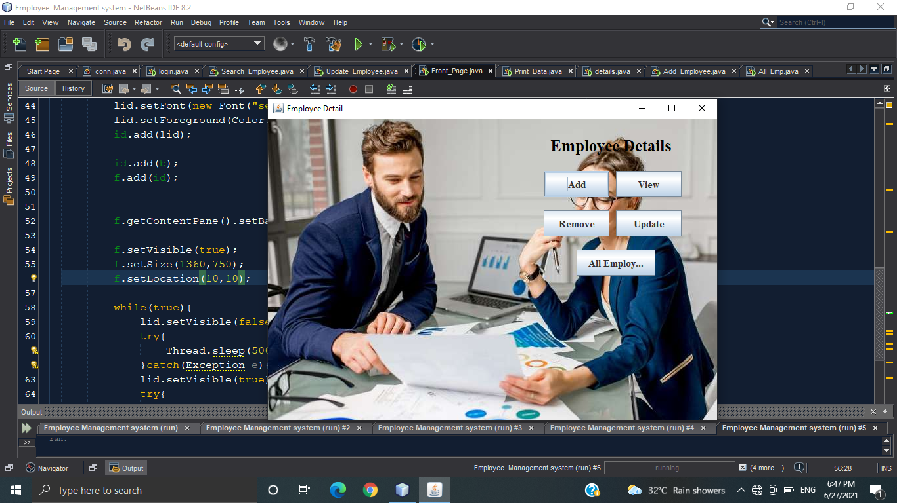
Employee-Detail Page

Slide 10
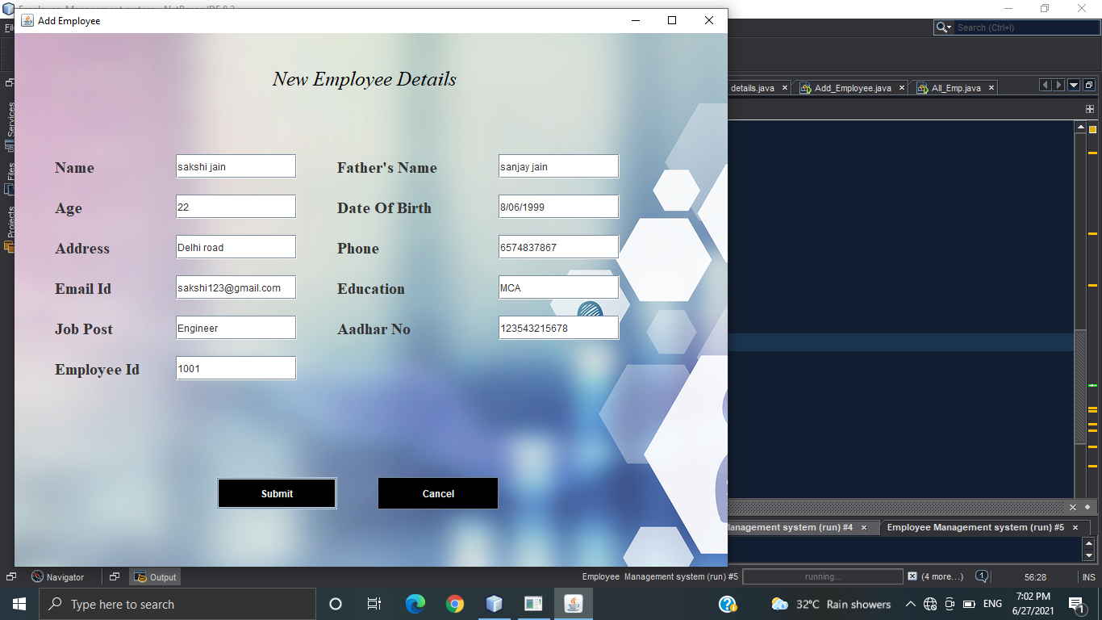
Add Employee Page

Slide 11
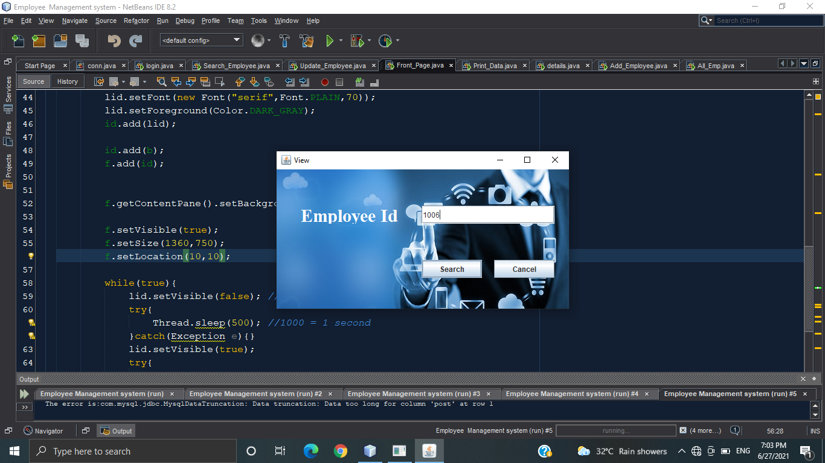
View Page

Slide 12
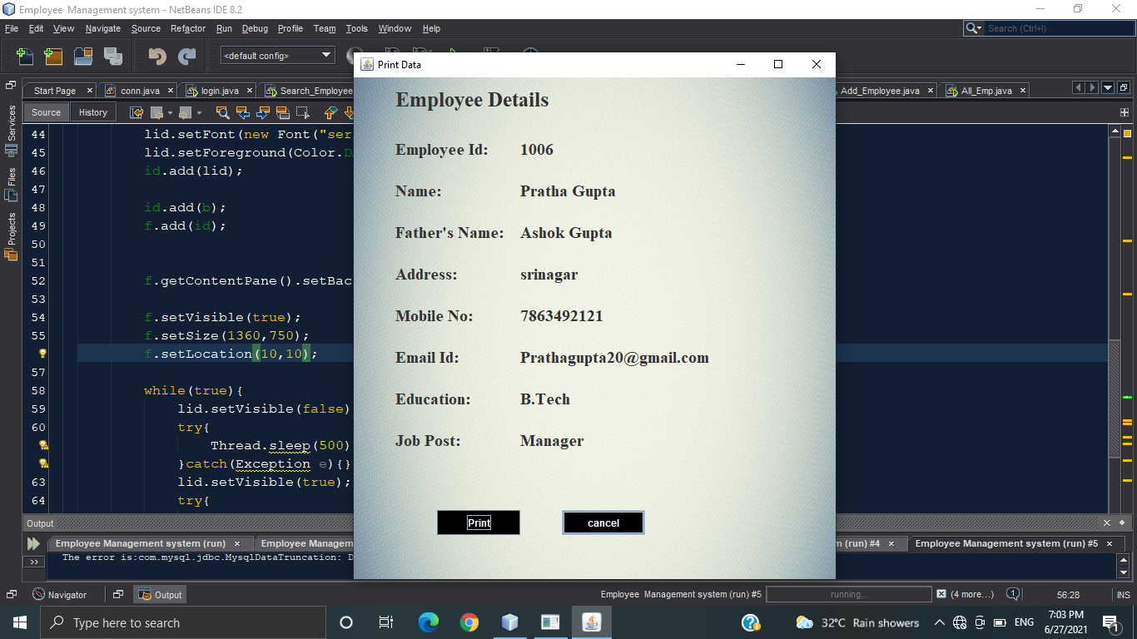
Print Data Page

Slide 13
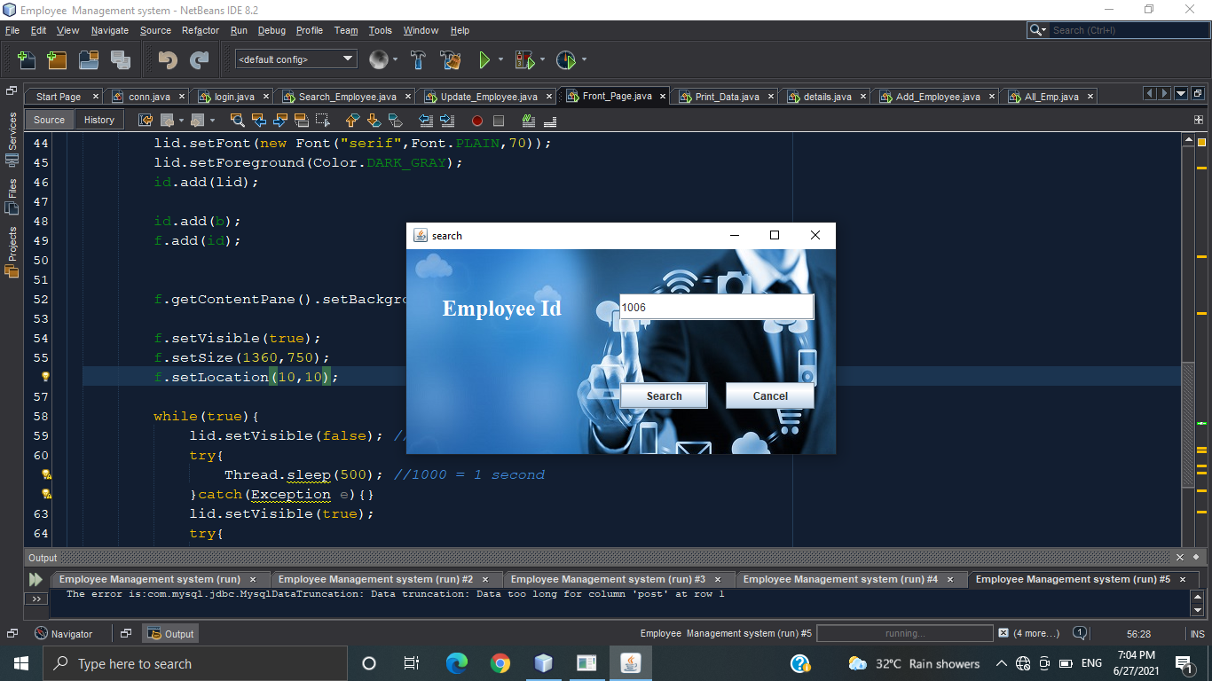
Search for Update Page

Slide 14
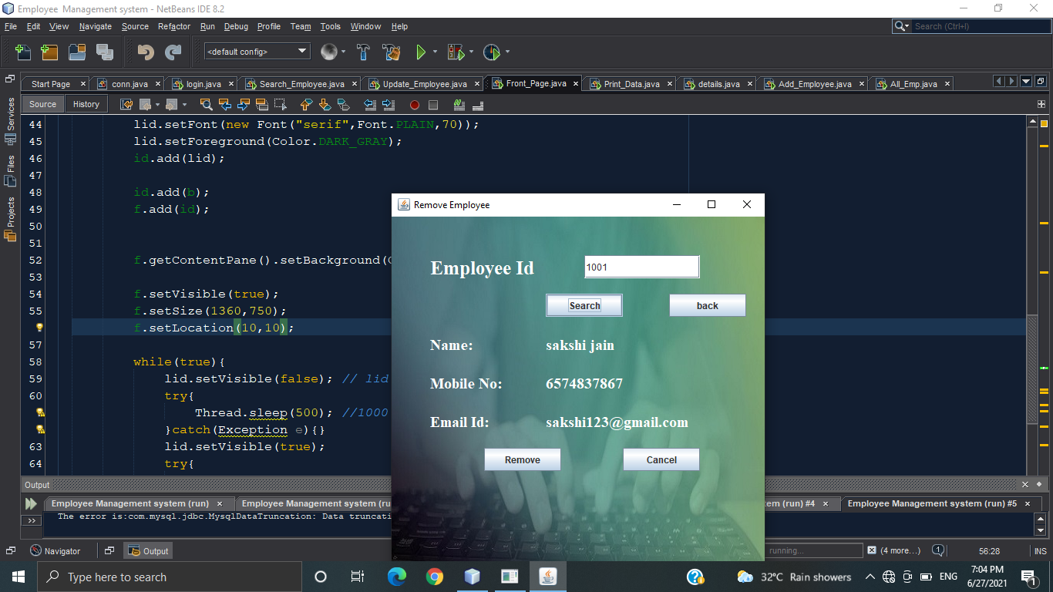
Remove Employee Page

Slide 15
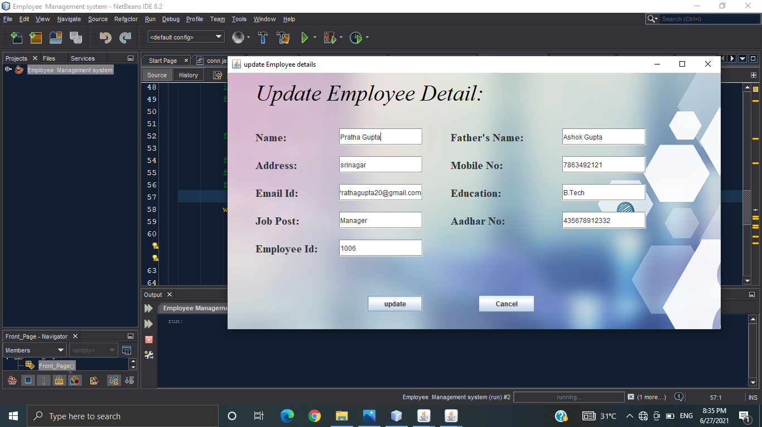
Update Employee Page

Slide 16
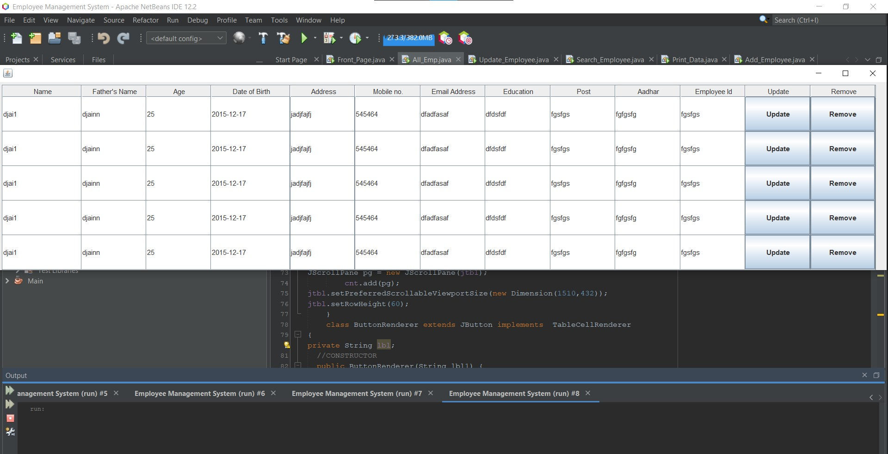
View All Employee Page

Slide 17
Future Enhancement
As a future work, some additional stuff could be implemented and integrated into the application code making it much more reliable and flexible; especially what concerns a pay-roll module, for instance.
Apparently, the role of such systems is basic and essential within each company that wants to keep a really good control and record concerning its personnel data, functionality and performance on all levels in its structure. Every organization, in nowadays, has the necessity of managing its staff on a really good level as the staff has definitely the greatest merit of building up a company as such as it is.
The well managed employee means giving the appropriate financial award-ness and all kind of benefits as such as they have been deserved. That’s why the development of such systems is not just a programming business – a lot of people are ordinarily involved in such projects and one of the basic requirements is the reliability of the system, especially what concerns the storage of data and all of the operations that will be performed upon it.

Slide 18
Thank you…

